Slide 1
Measuring Transition Risk in Investment Funds (or investment portfolios)
Ricardo Crisóstomo
October 4, 2024
(CNMV Working Paper No. 81)

Slide 2
Economy and Global Warming
Ecology: study of the relationships between living organisms, including humans, and their physical environment.
Our living standard has notably increased in the last centuries (industrialization, infrastructure technology, social care, economic growth, etc. )
But we live in a finite planet with limited resources (and very special conditions…)
Pursuing infinite growth in a finite planet is bound to generate clashes
Conflict and instability is bound to appear:
Limited natural resources (i.e: raw materials, food)
Limited energy sources (i.e: fossil fuels, nuclear fusion)
Risk of crossing planetary boundaries (i.e.: climate change, loss of biodiversity, ocean acidification)
¿Should we pursue continuous GDP / population growth in a finite planet?
Social, geographical, ethical and intergenerational conflicts embedded in these questions
Use of limited resources
Valuation of alternatives
(Cost–benefit analysis)
There are many uncertainties: we live in a complex system that is not fully understood.
But given a possibility of tipping points and potential catastrophic events, the risks should be at least considered (vs don’t look up?)

Slide 3
Transition risk
The transition towards a low-carbon economy might trigger a sudden revaluation of financial assets:
Changes in investors’ preferences, technological disruptions and the abrupt implementation of climate policies are expected to increase the costs of carbon-intensive firms while decreasing the demand for their products
Higher climate awareness and the disclosure of new environmental information could make investors to reduce or reject high-carbon investments
These changes could generate stranded assets, deteriorated credit quality, reduced firm valuations and higher financing costs, leading to losses in the financial instruments issued by transition-vulnerable firms.
Financial institutions and investors with ownership and debt links to high-carbon firms could be also affected by the transition through increased credit and market risk in their portfolios.
Transition risks should be appropriately weighted against the benefits of limiting global warming to analyze the costs and opportunities of the low-carbon transition

Slide 4
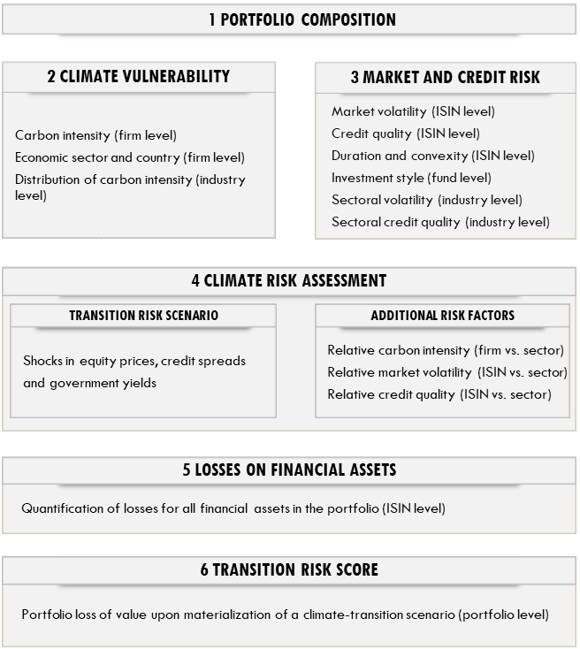
Measuring transition risk
We develop a comprehensive framework to measure transition risk in investment portfolios
Our approach considers both climate and financial risk metrics to measure transition risk.
The granularity is enriched by considering sectoral, geographical, company and ISIN-level data.
We consider 5 asset classes: 1) Equity; 2) Corporate bonds; 3) Sovereign debt, 4) Mutual funds; 5) Cash
The climate vulnerability of counterparties is derived from their carbon intensity and economic sector
Market and credit risk metrics are retrieved for each exposure to account for the varying degree of risk of different financial instruments and asset classes
This methodology allows us to quantify the loss of value that each individual (ISIN-level) exposure, and hence the corresponding portfolio, could suffer upon materialization of a transition risk scenario.

Slide 5
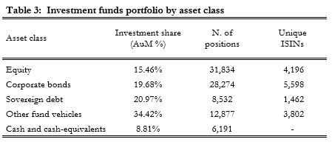
Data and metrics (1)
1 Portfolio composition:
Detailed (ISIN-level) composition of 1629 IFs
88,631 individual positions
Total AuM of EUR 307.4 billion
Five asset classes
2 Climate vulnerability
Raw carbon in : (firm level) Companies with high carbon footprint are expected to be more affected by the green transition.
Equity, corporate bonds and other funds: Total scope 1 and scope 2 CO2-equivalent emissions in tones normalized by net sales/revenue
Sovereign debt: Data retrieved as tC02e/GDP (and converted into tC02e/m$ for aggregate calculations).
Economic sector : (firm level): Sector characteristics impact the costs and opportunities arising from the transition:
25 economic segments: 23 NACEs for equity and corporate debt + sovereign debt + other funds
: (firm level): Company-specific drivers like their product mix, energy sources or technological portfolio can alter their climate risk profile
Carbon intensity
tC02e/m$
Economic sector
NACE code
Relative carbon intensity
Quantile of CI

Slide 6
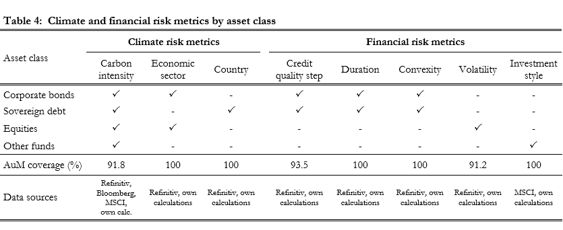
Data and metrics (2)
3 Credit and market risk:
MtM performance of financial instruments (even those issued by a given firm) will be typically different depending on the asset class considered and the risk characteristics of each individual exposure.
Credit risk (ISIN-level): Risk of loss can differ depending on , , , and and of each exposure.
Market risk (ISIN-level): Risk of loss can differ depending on of each underlying.
credit quality
duration
convexity
volatility
Credit and market risk metrics are employed to estimate the potential loss that financial instruments with different credit ratings, duration, convexity or price volatility can experience in a transition risk scenario

Slide 7
Climate scenario & downscaling
4 Transition risk scenario
Top-down modelling approach → ensure a consistent risk assessment across economic sectors, geographical breakdowns, asset classes and individual exposures.
NGFS delayed transition: → reliance in ESRB and ECB shocks for asset classes (EIOPA 2022 and ECB 2022)
23 Sectoral shocks for equity prices and corporate bond spreads (23 NACE codes)
35 Country shocks for government debt (35 countries, 10 maturity buckets per country)
5 Dowscalling to ISIN-level shocks
Improved granularity → climate vulnerability (firm-level) and financial risk metrics (ISIN-level)
Corporate bonds shocks =
Equity shocks =
Sovereign debt shocks =
Other funds shocks =
Intra-sector risk metrics → discriminate among the best- and worst-in class in each economic industry
Relative carbon intensity /
Volatiatl multipeir:
f(sectoral shock, carbon intensity, credit quality, duration, convexity)
f(sectoral shock, carbon intensity, volatility)
f(country shock, duration, convexity) + carbon intensity / credit quality in non-main countries
f(carbon intensity, investment style, asset class shocks)
( )
Relative carbon intensity / WACI
$$q_{j}({CI}_{i})$$
Quantile that obligor/issuer of exposure i occupies in the carbon intensity distribution of sector j
Volatility multiplier
$σ_{i,j}^{m}=σ_{i}$/ ${\overline{σ}}_{j}$
Credit risk multiplier
$${CQS}_{i,j}^{m}={CQS}_{i}/{\overline{ CQS}}_{j}$$
Credit risk multiplier

Slide 8
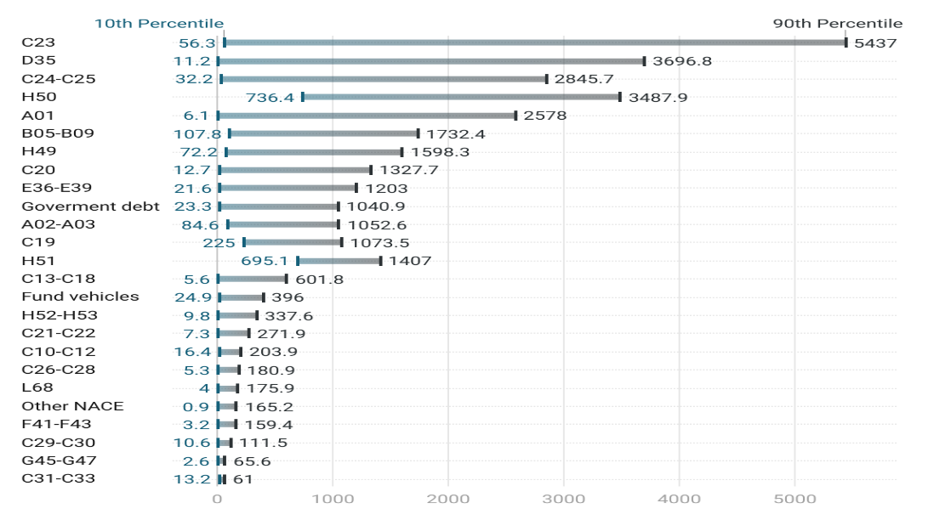
Carbon intensity data
C02 intensity by economic sector
Notable heterogeneity of carbon intensity across economic industries.
Highest carbon intensity in C23 (manufacture of other non-metallic products), D35 (electricity, gas, stem and air conditioning supply) and H50 (water transportation)
Information technology and professional, scientific and technical services (both in other NACE) among the lower emitters.
Most water-reliant
according to ENCORE:
A01, A02-03, B05-09,
D35, H50
Large intra-sector dispersion of GHG emissions in many economic segments.
C23 subsector range from 56.3 to 5,437 tC02eq/m$ (excluding outliers) (median CI 891.8 tC02e/m$)
Sectoral average/median carbon intensity can significantly over or underestimate transition risk

Slide 9
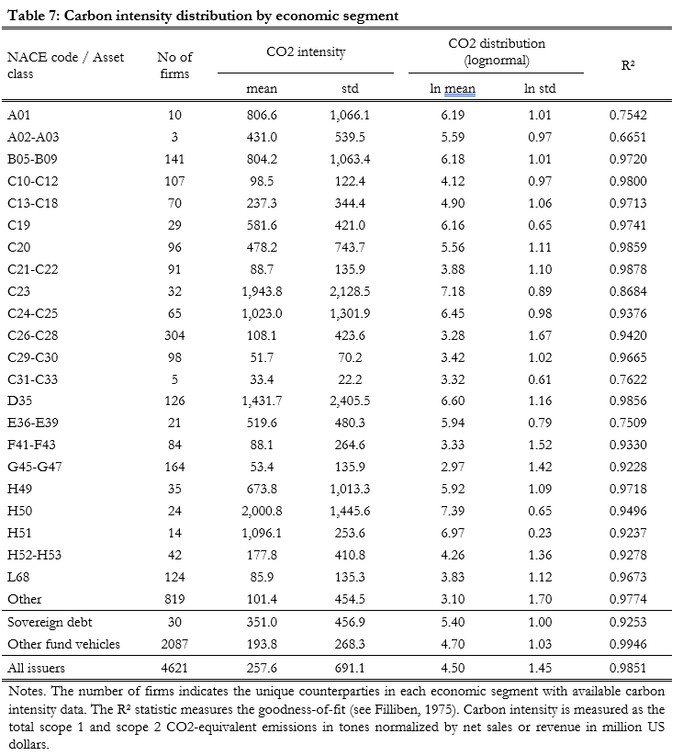
Carbon intensity modelling
We employ a lognormal distribution to model the carbon intensity of economic industries:
High-carbon emitters typically exhibit much higher carbon footprints than sectoral peers generating right-skewed distributions.
CI distribution for risk purposes can be assumed to be bounded by zero.
Lognormal distribution provides an increasingly good fit for carbon intensity as number of observations increase.
Q-Q plot of 4,621 counterparties. Lognormal model appropriately describes carbon intensity

Slide 10
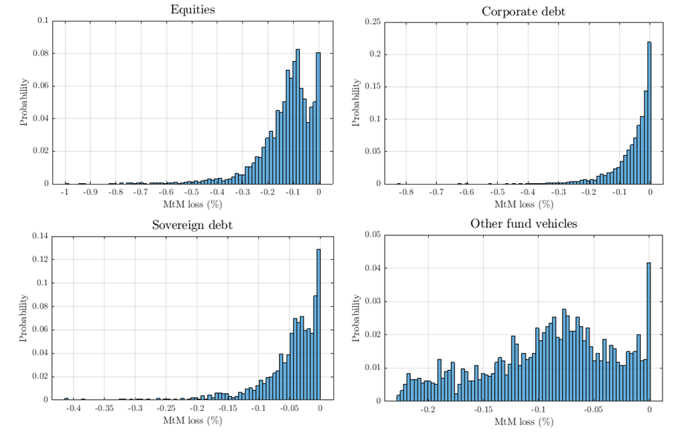
Transition risk by asset class
Transition risk losses by asset class
Substantial variability across instruments in each asset class.
Equities suffer the highest losses (-12.71% on average), followed by corporate bonds (-5.61%) and sovereign debt (-4.77%).
Worst 1% equities characterized by companies with a high-carbon footprint (1,812.3 tC02e/m$ on average) operating in highly pollutant sectors (NACEs B, C19 and D35)
In corporate debt, a large proportion of bonds suffer small MtM losses: driven by bonds issued by low-carbon companies and a large fraction of short maturity debts (→ small losses in a credit spread widening scenario).
Largest losses in corporate of high emitters (755.24 tC02e/m$) with long residual maturities (24.01 duration)
Sovereign debt outperforms other asset classes: two thirds of sovereign bonds suffer a loss lower than 5%
Highest losses in long-dated sovereign bonds (32.5 duration) of countries particularly exposed to the transition

Slide 11
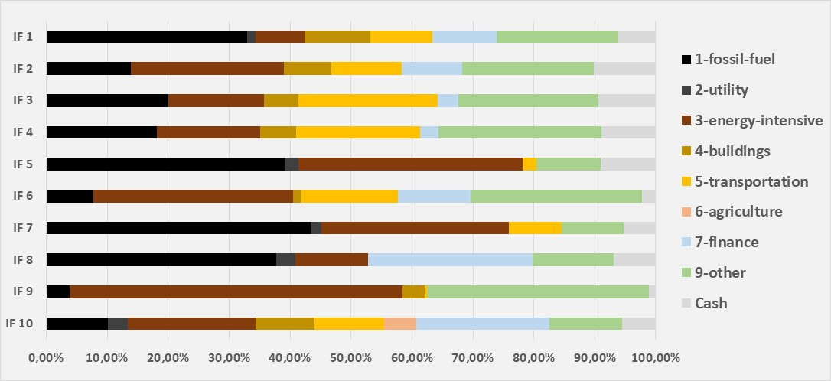
Transition risk in investment funds
Transition risk distribution for investment funds
Share of CPRS sectors: 10 worst performing funds
Investment funds suffer a moderate 5.7% loss upon materialization of a high transition risk scenario.
The risk distribution is significantly left-skewed, with the worst 1% funds experiencing an average loss of 21.3%.
Worst 1% funds: invest 94.8% in equities and AuM-weighted carbon intensity of 998.9 tC02e/m$ (compared to 15.46% and 137.2 WACI in the overall fund sector)
10 worst performing funds: 64.6% of their portfolio in the Climate Policy Relevant Sectors (CPRS) (compared with 12.2% in the overall fund sector)
Best 1% funds are in liquidation/constitution or have majority of their portfolio in cash and cash-equivalents

Slide 12
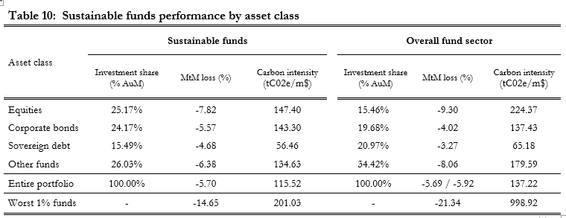
Sustainable funds
Sustainable funds exhibit significant differences with the aggregate fund sector in terms of transition risk
Sustainable funds
Higher share of equities (25.2% vs 15.5% in fund sector)
Lower carbon intensity (115.52 vs 137.22 in fund sector)
Outperform the fund sector (despite overweighting the riskier asset class)
Tail risk: Worst 1% and 5% sustainable funds experience 14.6% and 11.0% loss (vs. 21.3% and 15.5%)
Average return: MtM loss across all sustainable funds is -5.70% vs -5.92% in comparable portfolio
Outperformance of sustainable funds is driven by a choice of sectors and issuers with lower carbon intensity
In equities and other fund vehicles, sustainable funds invest in instruments with lower C02 footprint
Equity portfolio of sustainable funds → carbon intensity: 147.40 ; MtM loss: -7.82%.
Equity portfolio of entire sector → carbon intensity: 224.37 ; MtM loss: -9.30%
Climate outperformance of sustainable funds is not homogeneous is all asset classes
CB portfolio exhibits a slightly higher carbon intensity (143 vs 137) and MtM loss (-5,6% vs. -4,0%)
Choices of sustainable funds in CB can be further improved to obtain a more climate-friendly portfolio

Slide 13
Conclusion & future refinements
We develop a global framework to measure the impact of the climate transition on investment portfolios
Our analysis include geographical, sectoral, company and ISIN-level data
We discriminate among financial instruments by considering the carbon footprint of specific counterparties and the credit rating, duration, convexity and volatility of individual exposures.
Investment funds suffer a moderate -5.7% loss in a high transition risk scenario
Risk distribution is significantly left-skewed; worst 1% funds suffer an average loss of -21.3%.
Equities are the worst performers (-12.7%), followed by corporate bonds (-5.6%) and government bonds (-4.8%).
Substantial variability across the financial instruments in each asset class:
1% worst equities: -70.9% average loss
1% worst corporate bonds: -37.2% average loss
1% worst sovereign debt: -31.0% average loss
1% worst other funds: -22.2% average loss
Sustainable funds less exposed to transition risk and perform better than the fund sector.
Validates their choice as green investments
Spanish funds exhibit lower transition risk than EU counterparts.

Slide 14
Future refinements
Scope 3 emissions: Inclusion of scope 3 emissions could further improve the discrimination across portfolios, economic sectors and individual counterparties.
Availability and quality issues in the reporting of scope 3 emissions hinder their systematic use.
Transition risk vs physical risk: Relation between transition costs and future physical risk
Although the climate transition will generate substantial costs, these risks should be weighed against the benefits of limiting global warming.
Derivative positions: Although Spanish funds make limited use of derivatives, quantifying the risk exposure through derivatives (which affect both market and counterparty risk) improve the risk assessment.
Look-through in other funds: Increase granularity and discrimination
Particularly relevant in interconnection analyses
Second other effects: Analysis consider direct, first-round effects of the climate transition.
Amplifying factors like the fund-flow relation, market impact, indirect contagion or other system-wide drivers could trigger feedback loops and non-linear effects that significantly increase the final loss.
Management fees, depositary fees and other expenses are not included in the calculation as they are not related to the climate transition.
The dynamic behavior of fund managers in response to transition risk could also increase or reduce the MtM loss.
Scope 3 emissions
Transition risk vs physical risk
Derivative positions
Look-through in other funds
Second other effects:

Slide 15
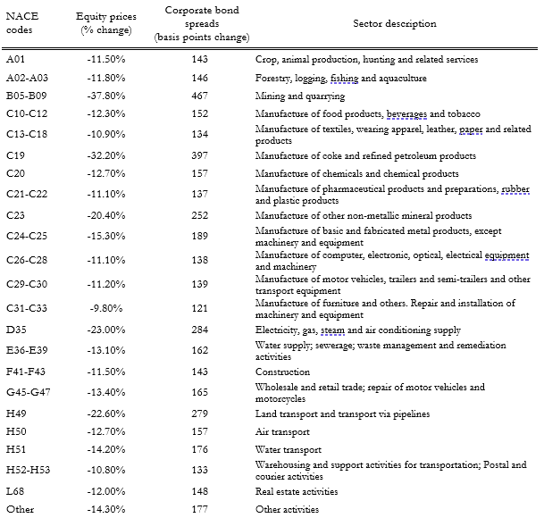
Appendix: Shocks in equity prices and corporate bond spreads
NFGS delayed transition scenario
Climate policies not introduced until 2030
Abrupt/disorderly implementation required to limit global warming.
Rapid increase in carbon prices generates geographical and sectoral shocks which affect the economy
Macroeconomic and environmental projections obtained from NiGEM and REMING-MagPIE
23 sectoral shocks calculated by ESRB/ECB.
Concentrate impact in asset prices over a 3-year period (2030-33)
Used in 2022 EIOPA and ECB climate stress test

Slide 16
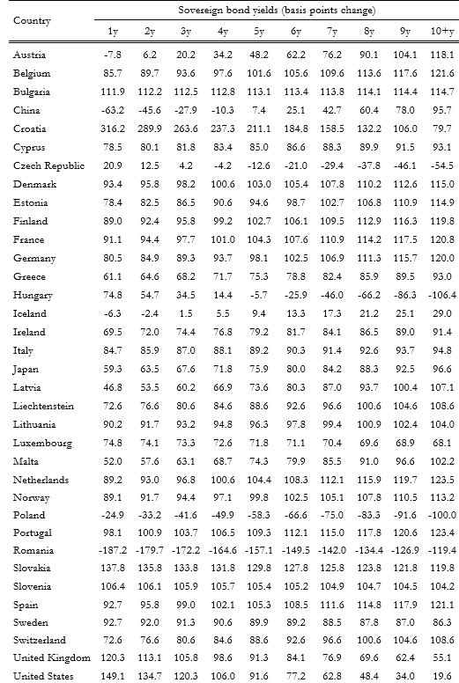
Appendix: Shocks in sovereign debt yields
35 countries and 10 maturities
Climate policies not introduced until 2030
Abrupt/disorderly implementation required to limit global warming.
Rapid increase in carbon prices: Generates geographical and sectoral shocks which affect the overall economy
Macroeconomic and environmental projections obtained from NiGEM and REMING-MagPIE

Slide 17
Appendix: ISIN-level shocks for equities
Equity shocks considers both climate vulnerability and financial risk
Climate vulnerability obtained from the economic sector and carbon intensity of counterparties
First, we obtain the carbon intensity multiplier ${CI}_{i,j}^{m}$
ASASA → $q_{j}({CI}_{i})$quantile that issuer of i occupies in the carbon distribution of sector j
${\text{→} CI}_{i,j}^{m}$ ranges from 0 to 2, discriminating among firms in each economic sector
Next, the market risk multiplier $σ_{i,j}^{m}$
$σ_{i,j}^{m}=\frac{σ_{i}}{{\overline{σ}}_{j}}$ → ratio of the volatility of each exposure $σ_{i}$ compared with sectoral volatility ${\overline{σ}}_{j}$
The loss of value in equity position i, j is obtained as
${ΔEQ}_{i,j}^{}(k)={CI}_{i,j}^{m} σ_{i,j}^{m}{ Δ}_{j}^{EQ}(k)$
where $Δ_{j}^{EQ}$(k) represents the average equity loss in sector j in transition scenario k.
$${CI}_{i,j}^{m}=2q_{j}\left({CI}_{i}\right)$$
$$σ_{i,j}^{m}=\frac{σ_{i}}{{\overline{σ}}_{j}}$$
$${ΔEQ}_{i,j}^{}(k)={CI}_{i,j}^{m} σ_{i,j}^{m}{ Δ}_{j}^{EQ}(k)$$

Slide 18
Appendix: ISIN-level shocks for corporate bonds
Corporate bond shocks considers both climate vulnerability and financial risk
Climate vulnerability obtained from the economic sector and carbon intensity of counterparties
First, we obtain the carbon intensity multiplier ${CI}_{i,j}^{m}$
ASASA → $q_{j}({CI}_{i})$quantile that obligor of i occupies in the Carbon distribution of sector j
${\text{→} CI}_{i,j}^{m}$ ranges from 0 to 2, discriminating among firms in each economic sector
Next, the credit risk multiplier ${CQS}_{i,j}^{m}$
→ ratio of CQS of each exposure compared with sectoral CQS
Change in credit spread for each corporate bond i, j is
where $Δ_{j}^{EQ}$(k) represents the average equity loss in sector j in transition scenario k.
Loss of value for each corporate bond obtained as:
where ${SD}_{i}$ and $C_{i}$ represent the credit spread duration and the convexity of bond i
$${CI}_{i,j}^{m}=2q_{j}\left({CI}_{i}\right)$$
$${CQS}_{i,j}^{m}=\frac{{CQS}_{i}}{{\overline{CQS}}_{j}}$$
$${ΔCS}_{i,j}^{}\left(k\right)={CI}_{i,j}^{m}{{ CQS}_{i,j}^{m} Δ}_{j}^{CS}(k)$$
$${ΔCB}_{i,j}^{}\left(k\right)={ΔCS}_{i,j}^{}\left(k\right){SD}_{i }+{0,5ΔCS}_{i,j}^{}{\left(k\right)}^{2}C_{i}$$

Slide 19
Appendix: ISIN-level shocks for sovereign debt
Sovereign debt shocks are separately estimated for each country
For countries included in transition pathway k:
For countries that are not included, we obtain the carbon intensity multiplier ${CI}_{i,h}^{m}$
ASASA →$q_{}^{GB}({CI}_{i})$ quantile that county h occupies in the sovereign carbon distribution
${\text{→} CI}_{i,h}^{m}$ ranges from 0 to 2, discriminating among sovereign countries
Next, the credit risk multiplier ${CQS}_{i,h}^{m}$
→ ratio of CQS of each exposure compared with average sovereign CQS
Change in yield for sovereign bond i, j is
where $Δy_{T}\left(k\right)$ represents the average yield change in sovereign debt of maturity T.
Loss of value for each sovereign bond:
where ${SD}_{i}$ and $C_{i}$ represent the credit spread duration and the convexity of bond i
$${ΔGB}_{i,h,T}^{}\left(k\right)= {Δy}_{h,T}^{}\left(k\right)D_{i}^{}+{0.5Δy}_{h,T}^{2}\left(k\right)C_{i}$$
$${CI}_{i,h}^{m}={2q}_{}^{GB}({CI}_{i})$$
$${CQS}_{i,h}^{m}=\frac{{CQS}_{i}}{{\overline{CQS}}_{h}}$$
$${Δy}_{i,h,T}^{}\left(k\right)={CI}_{i,h}^{m} {CQS}_{i,h}^{m} {Δy}_{T}^{}\left(k\right)$$
$${ΔGB}_{i,h,T}^{}\left(k\right)={Δy}_{i,h}^{}\left(k\right)D_{i}^{}+0.5{Δy}_{h,T}^{2}\left(k\right)C_{i}$$

Slide 20
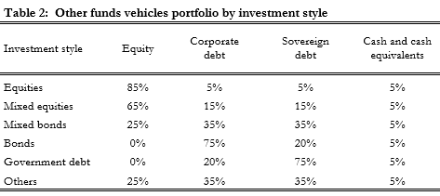
Appendix: ISIN-level shocks for other funds
Other funds shocks considers both climate vulnerability and financial risk
Climate vulnerability obtained from the carbon intensity and portfolio composition
First, we obtain the carbon intensity multiplier ${CI}_{i,j}^{m}$
ASASA →$q_{}^{IF}({CI}_{i})$quantile that fund i occupies in the fund sector carbon distribution
${\text{→} CI}_{i,j}^{m}$ ranges from 0 to 2, discriminating among funds
Next, the change in value in fund i of investment style is obtained as
$${CI}_{i}^{m}=q_{}^{IF}({CI}_{i})$$
$${ΔIF}_{i,s}^{}\left(k\right)={CI}_{i}^{m}\left[w_{s}^{EQ}\overline{ΔEQ}\left(k\right)+w_{s}^{CB}\overline{ΔCB}\left(k\right)+w_{s}^{GB}\overline{ΔGB}(k)\right]$$
$w_{s}^{EQ}$, $w_{s}^{CB}$ and $w_{s}^{GB}$ are the share of the portfolio that each fund held in equities, corporate bonds and sovereign debt
$\overline{ΔEQ}\left(k\right)$, $\overline{ΔCB}\left(k\right)$ and $\overline{ΔGB}(k)$ are the average change in value of equities, corporate bond and sovereign debt

