Slide 1


La naturaleza como capital natural
Second Brainstorming Session-Observatorio del Agua de la Fundación Botín, Madrid 18 Junio 2016
Bárbara A. Willaarts
Centro de Estudios e Investigaciones de Riesgos Agrarios y Medioambientales (CEIGRAM), Universidad Politécnica de Madrid
Observatorio del Agua de la Fundación Botín
1/12
Notes:
http://www.magrama.gob.es/es/desarrollo-rural/temas/gestion-sostenible-regadios/plan-nacional-regadios/texto-completo/

Slide 2
Contenidos
La naturaleza y su contribución al bienestar humano
Era de cambios e incertidumbres…también para nuestros ecosistemas
Desafíos y oportunidades en España
2/12
Notes:
BOUNDARY CONDITIONS
The purpose of the project: exploring what means in practice the WFE in a country like Spain and how relevant such approach could be e.g. in pilyc impact assessment.
Our approach at the beginning was explorative. We did not had any concrete research question. We were just interested in finfind out if WFE was relevant or not for Spain.
To address this project we conducted over ten personal inverviews with experts in the field of water, energy, agriculture, environment, etc and asked about their oppinion on this nexus approach and which components and interlinkages of the nexus where most important at national level.
We also conducted a workshop with another group of 15 experts to address the revelance of the different links and we found out

Slide 3

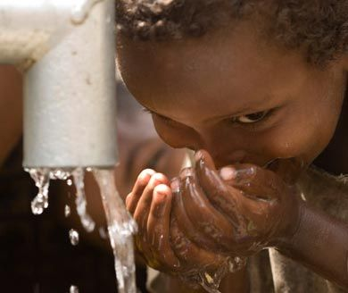

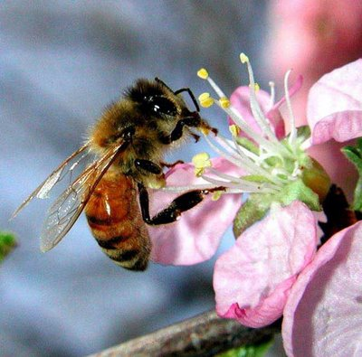
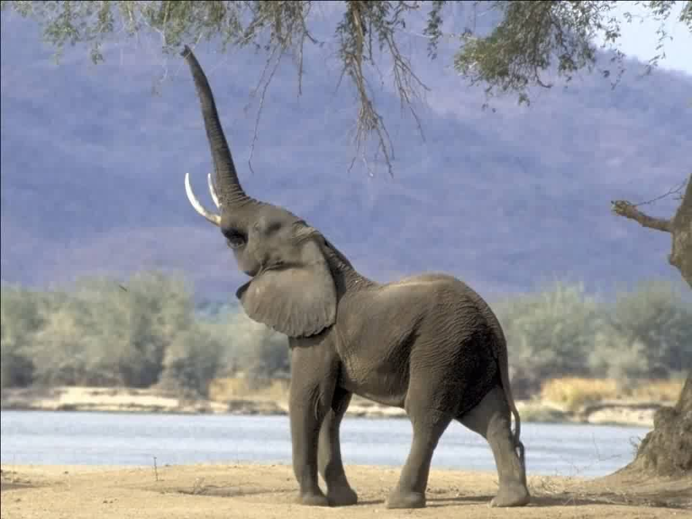
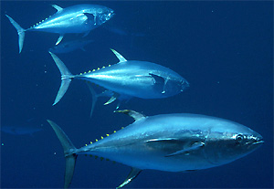
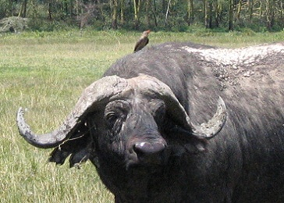
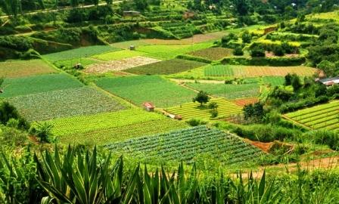
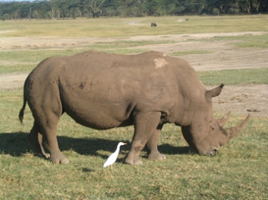
Argumentos éticos pero también prácticos para conservar la naturaleza
Los “5 grandes” son espectaculares
Pero la naturaleza es mucho más que especies emblemáticas. Es la base sobre la cual se sostiene nuestro propio bienestar
3/12
Notes:
BOUNDARY CONDITIONS
The purpose of the project: exploring what means in practice the WFE in a country like Spain and how relevant such approach could be e.g. in pilyc impact assessment.
Our approach at the beginning was explorative. We did not had any concrete research question. We were just interested in finfind out if WFE was relevant or not for Spain.
To address this project we conducted over ten personal inverviews with experts in the field of water, energy, agriculture, environment, etc and asked about their oppinion on this nexus approach and which components and interlinkages of the nexus where most important at national level.
We also conducted a workshop with another group of 15 experts to address the revelance of the different links and we found out

Slide 4
La naturaleza entendida como un capital natural
Servicios de los ecosistemas: beneficios directos e indirectos que la sociedad obtiene de la naturaleza (MEA, 2005)
Abastecimiento:
Regulación:
Culturales:
Bienes de origen biótico o geótico aprovechables. Ej: agua, minería, pesquería, recursos forestales
Contribuciones indirectas al bienestar humano provenientes del buen funcionamiento de los procesos ecológicos. Ej: aire limpio, regulación del clima, descomposición de la materia orgánica
Contribuciones intangibles que las personas obtienen a través de su experiencia directa con los ecosistemas y su biodiversidad. Ej: valor estético, eco-turismo, arte
4/12
Notes:
BOUNDARY CONDITIONS
The purpose of the project: exploring what means in practice the WFE in a country like Spain and how relevant such approach could be e.g. in pilyc impact assessment.
Our approach at the beginning was explorative. We did not had any concrete research question. We were just interested in finfind out if WFE was relevant or not for Spain.
To address this project we conducted over ten personal inverviews with experts in the field of water, energy, agriculture, environment, etc and asked about their oppinion on this nexus approach and which components and interlinkages of the nexus where most important at national level.
We also conducted a workshop with another group of 15 experts to address the revelance of the different links and we found out

Slide 5
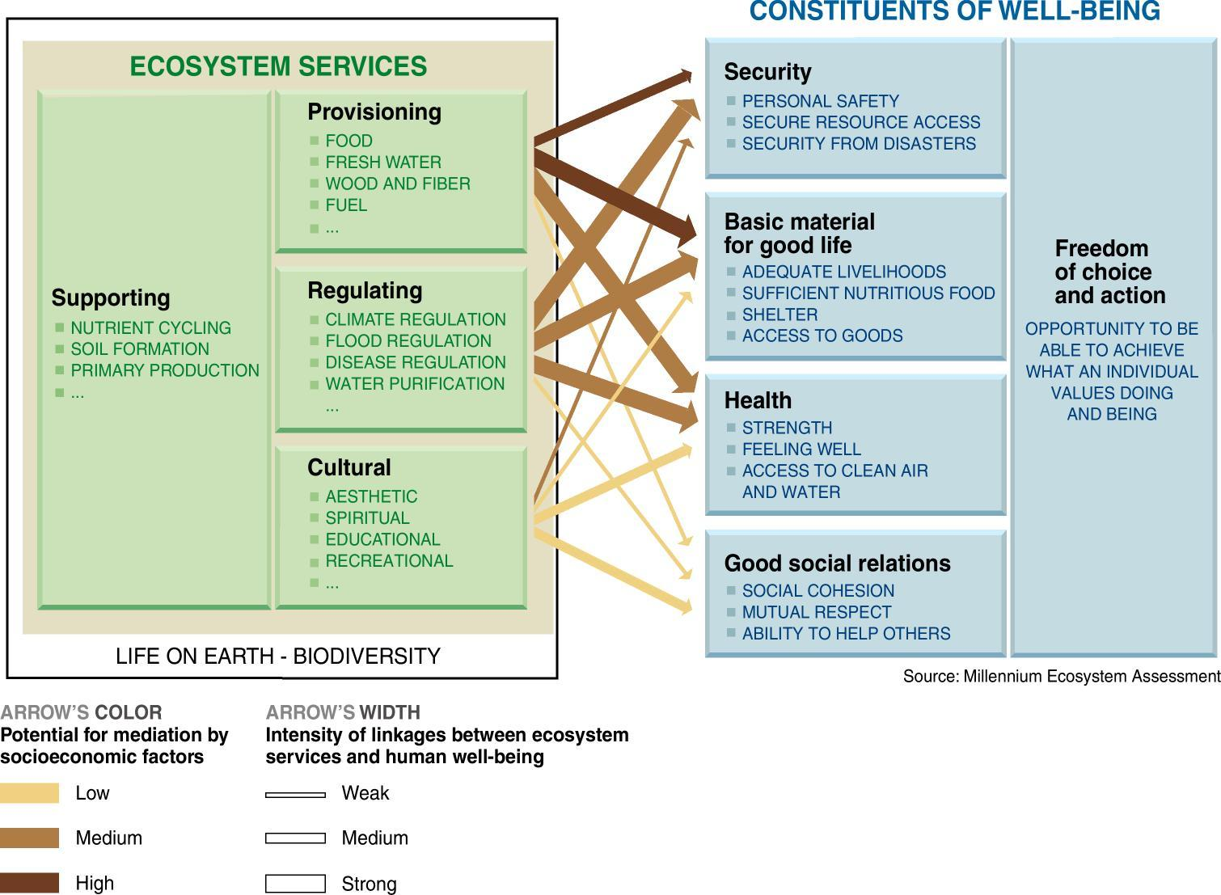
¿Cómo la naturaleza contribuye a nuestro bienestar?
Millennium Ecosystem Assessment (2005)
5/12
Notes:
BOUNDARY CONDITIONS
The purpose of the project: exploring what means in practice the WFE in a country like Spain and how relevant such approach could be e.g. in pilyc impact assessment.
Our approach at the beginning was explorative. We did not had any concrete research question. We were just interested in finfind out if WFE was relevant or not for Spain.
To address this project we conducted over ten personal inverviews with experts in the field of water, energy, agriculture, environment, etc and asked about their oppinion on this nexus approach and which components and interlinkages of the nexus where most important at national level.
We also conducted a workshop with another group of 15 experts to address the revelance of the different links and we found out

Slide 6
Repensando nuestra relación con la naturaleza
society
nature
…pero es conveniente o imprescindible repensar estas interrelaciones
nature
economy
society
Las percepción de los 3 sistemas
Factores socio-culturales influyen en esta percepción:
Religión (ej. Cristianismo y la dominación de la naturaleza ); Desarrollo tecnológico (ej. Sustitución de procesos ecológicos); Urbanización (ej. Comida viene de la nevera y el agua del grifo); Económicos (ej. Modelo imperfecto que no integra externalidades)
6/12
Notes:
BOUNDARY CONDITIONS
The purpose of the project: exploring what means in practice the WFE in a country like Spain and how relevant such approach could be e.g. in pilyc impact assessment.
Our approach at the beginning was explorative. We did not had any concrete research question. We were just interested in finfind out if WFE was relevant or not for Spain.
To address this project we conducted over ten personal inverviews with experts in the field of water, energy, agriculture, environment, etc and asked about their oppinion on this nexus approach and which components and interlinkages of the nexus where most important at national level.
We also conducted a workshop with another group of 15 experts to address the revelance of the different links and we found out

Slide 7
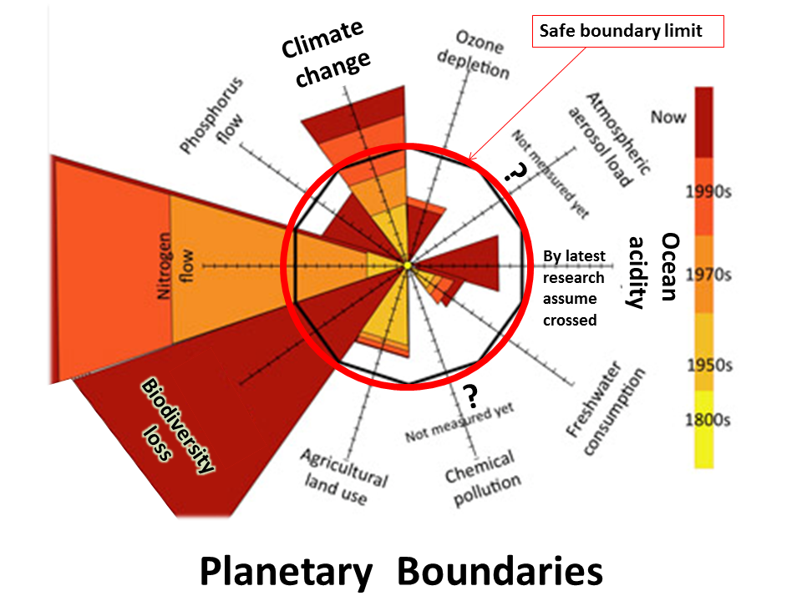
Síntomas de agotamiento del planeta
7/12
Notes:
BOUNDARY CONDITIONS
The purpose of the project: exploring what means in practice the WFE in a country like Spain and how relevant such approach could be e.g. in pilyc impact assessment.
Our approach at the beginning was explorative. We did not had any concrete research question. We were just interested in finfind out if WFE was relevant or not for Spain.
To address this project we conducted over ten personal inverviews with experts in the field of water, energy, agriculture, environment, etc and asked about their oppinion on this nexus approach and which components and interlinkages of the nexus where most important at national level.
We also conducted a workshop with another group of 15 experts to address the revelance of the different links and we found out

Slide 8
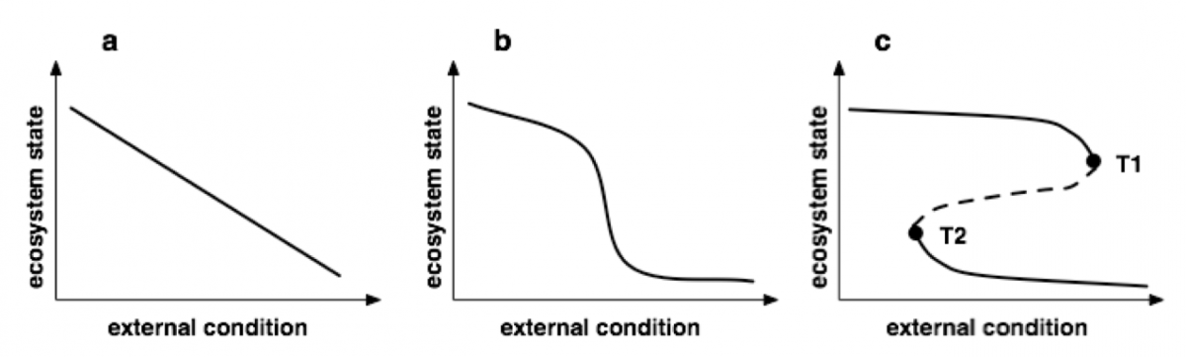
Posibles respuestas de un sistema
Scheffer and Carpenter (2003)
Incertidumbre sobre donde estamos en este momento, y cómo responderá el sistema si continúan las “perturbaciones”. La respuesta lineal es la menos probable.
8/12
Notes:
Scheffer 2010 Nature
omplex systems: foreseeing tipping points
The purpose of the project: exploring what means in practice the WFE in a country like Spain and how relevant such approach could be e.g. in pilyc impact assessment.
Our approach at the beginning was explorative. We did not had any concrete research question. We were just interested in finfind out if WFE was relevant or not for Spain.
To address this project we conducted over ten personal inverviews with experts in the field of water, energy, agriculture, environment, etc and asked about their oppinion on this nexus approach and which components and interlinkages of the nexus where most important at national level.
We also conducted a workshop with another group of 15 experts to address the revelance of the different links and we found out

Slide 9
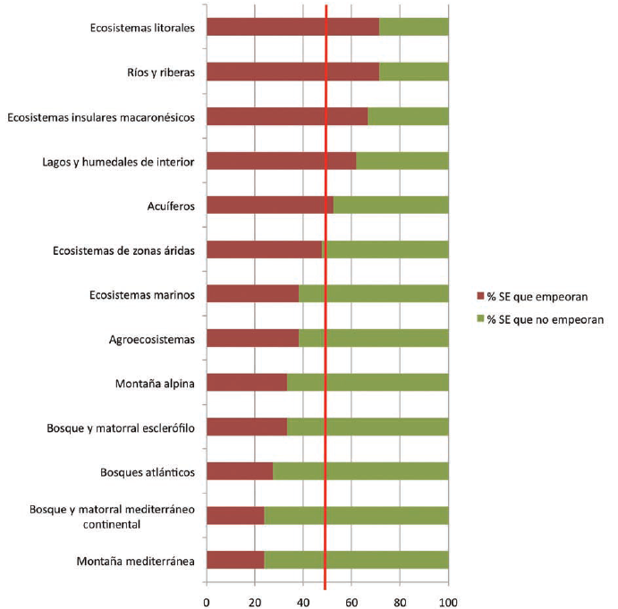
Estado del capital natural en España
9/12
Evaluación de los Ecosistemas del Milenio de España (2011).
Notes:
BOUNDARY CONDITIONS
The purpose of the project: exploring what means in practice the WFE in a country like Spain and how relevant such approach could be e.g. in pilyc impact assessment.
Our approach at the beginning was explorative. We did not had any concrete research question. We were just interested in finfind out if WFE was relevant or not for Spain.
To address this project we conducted over ten personal inverviews with experts in the field of water, energy, agriculture, environment, etc and asked about their oppinion on this nexus approach and which components and interlinkages of the nexus where most important at national level.
We also conducted a workshop with another group of 15 experts to address the revelance of the different links and we found out

Slide 10
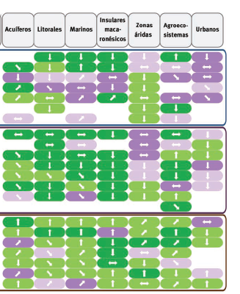
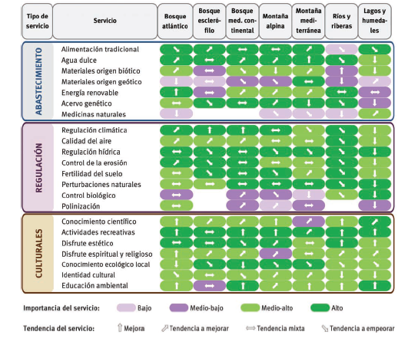
Estado del capital natural en España
10/12
Evaluación de los Ecosistemas del Milenio de España (2011).
Notes:
BOUNDARY CONDITIONS
The purpose of the project: exploring what means in practice the WFE in a country like Spain and how relevant such approach could be e.g. in pilyc impact assessment.
Our approach at the beginning was explorative. We did not had any concrete research question. We were just interested in finfind out if WFE was relevant or not for Spain.
To address this project we conducted over ten personal inverviews with experts in the field of water, energy, agriculture, environment, etc and asked about their oppinion on this nexus approach and which components and interlinkages of the nexus where most important at national level.
We also conducted a workshop with another group of 15 experts to address the revelance of the different links and we found out

Slide 11
Mensajes
Es imprescindible comenzar a reconocer que los sistemas sociales y naturales no son sistemas independientes, sino un único socio-ecosistema. Los impactos socio-económicos asociados a fenómenos de degradación ambiental (ej. CC, pérdida biodiversidad) nos lo demuestran
La degradación de la naturaleza puede ser un lujo, incluso en los países ricos. La tecnología es cara y no siempre reemplaza lo que la naturaleza es capaz de proporcionarnos y gratis
La monetarización de los beneficios derivados de los servicios de los ecosistemas es un paso para medir la contribución al bienestar social material, y visibilizar así los beneficios no materiales, aunque resulta imposible y equivocado pensar que todo se rige por los euros
11/12
Notes:
BOUNDARY CONDITIONS
The purpose of the project: exploring what means in practice the WFE in a country like Spain and how relevant such approach could be e.g. in pilyc impact assessment.
Our approach at the beginning was explorative. We did not had any concrete research question. We were just interested in finfind out if WFE was relevant or not for Spain.
To address this project we conducted over ten personal inverviews with experts in the field of water, energy, agriculture, environment, etc and asked about their oppinion on this nexus approach and which components and interlinkages of the nexus where most important at national level.
We also conducted a workshop with another group of 15 experts to address the revelance of the different links and we found out

Slide 12
Gracias
barbara.willaarts@upm.es
www.ceigram.upm.es
12/12

